Slide 1
Mobile from CS

Slide 2
Minified
Reduces the file size.
Removes whitespace, comments, shortens lengthy variables
Easy file load and min version will take less time to download.

Slide 3
Bootstrap themes
bootstrap.css is the core css for BootStrap that defines all the style for various controls/components, where as bootstrap-theme.css defines the themes (gradient/animation) for buttons,dropdown menu,navbar,progressbar,panels.
Most of the times adding bootstrap.css is enough for bootstrap to work, but for gradient/animation, you can use bootstrap-theme.css.
First, bootstrap-theme.css is nothing else but equivalent of Bootstrap 2.x style in Bootstrap 3
bootstrap.css is completely styled and ready to use, if such is your desire. It is perhaps a bit plain but it is ready and it is there. "Load the optional Bootstrap theme for a visually enhanced experience." extended styling (3D buttons, gradients etc). This file is optional and does not effect the functionality of bootstrap at all, it only enhances the appearance.

Slide 4
Fluid and responsive layouts
Fluid layout adapts itself to different browser window sizes : all the values used are calculated proportionally to the viewport size, so when resizing, all the columns are resized, but the general layout stays the same.
Responsive layout is able to adapt itself to different sizes as well, but when resizing, the number of columns changes according to the available space. You could think of, for example, you website being resized to one column only on a smartphone.
Relative length units specify a length relative to another length property. Relative length units scales better between different rendering mediums.em - Relative to the font-size of the element (2em means 2 times the size of the current font) The em and rem units are practical in creating perfectly scalable layout!%
The absolute length units are fixed and a length expressed in any of these will appear as exactly that size.
Absolute length units are not recommended for use on screen, because screen sizes vary so much. However, they can be used if the output medium is known, such as for print layout.Cm,mm,in,px,pt,pc

Slide 5
What is web?
Web isn limited to one particular device or one environment. Web is universal. It must work with any form on info. It must also be accesible from any device. Our designs must work on universal web.
Web Design:
Mobile Design
Adaptive Design
Responsive Design
Fluid Layouts
Adaptive Design
Responsive design
Fluid type setting - we convert pixels to ems i.e. Relative font size. Th e concept of relative font size is used in fuild layouts and layouts that scale.

Slide 6
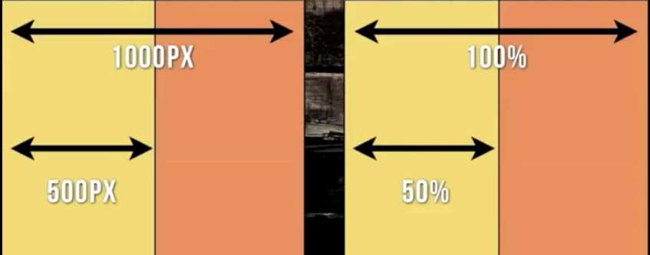
Fluid layouts
Fluid foundations
Fluid grids
Fluid layouts are layouts that scale and fixed layouts r layouts that r static. Fluid site is made of fluid grid. A grid is a series of same sized columns spaced apart evenly across page. Grids make the design more legible and better organized from design stand point. Fluid layouts have relative values(percentage). Mostly in the form of percentages. Now if u resize the element it wud b proportional o relative to its containing element. The site scales based on the size of the viewport

Slide 7
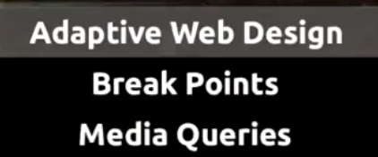
Adaptive web design
3 main thgs:

Slide 8
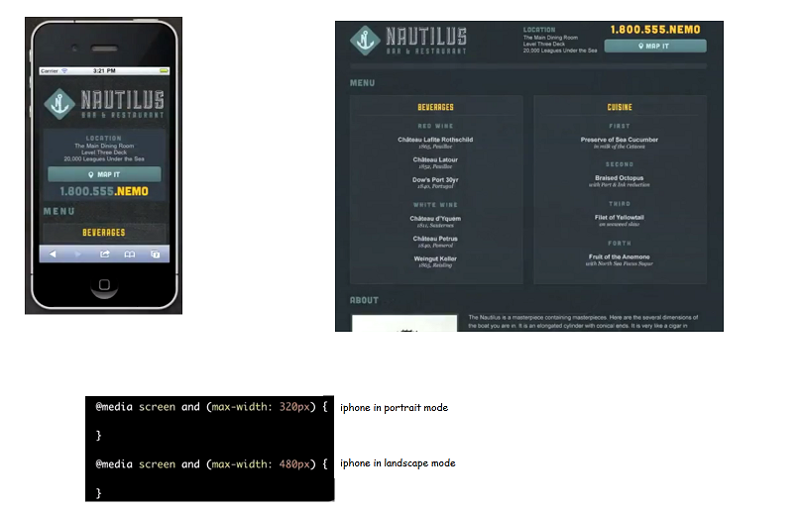

Slide 9
Adaptive web design
What is adaptive design? Adaptive web design is for controlled adaptation i.e. If u know the device o the design context dat u need to design for and then design accordingly. Desktop optimize sites work on mobile device but u have to zoom in a lot and swipe a lot
If u have a website built fa desktop u can either 1. separate mobile site - using separate markup, separate style and separate content.2.Adaptive design - to adapt the site from desktop to mobile envi 3.Responsive design
Adaptive design dosn means it covers al of the web . It jus means that yo designing fa specific context like device o screen size o resolution. Wat it basically means u know wat it is n yo specifically targetting that context
Wid any designs u need to consider four basic principles:who is yo userhow wil they use d site context(i.e. What device)content (how will they adapt)
In Adaptive web design we have to see 3 main things
Adaptive markup
Break points – wer yo design breaks down. It is typically the height and width of the target viewport. We have iphone, andriod, kindles , ipads (iphones height 480px and width 320px)
Media queries

Slide 10
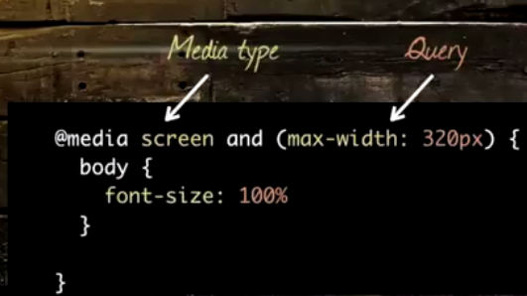
Media queries
Will der b diff files fa diff media queries and wil all b loaded?
Media query is a CSS technique introduced in CSS3.
It uses the @media rule to include a block of CSS properties only if a certain condition is true.
max-width: 769px means nethg below 769. (769 will not be included)
max-width values are 1 fewer than the mobile-first min-width

Slide 11
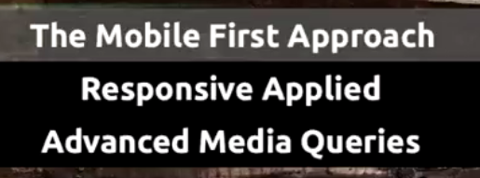
Responsive

Slide 12
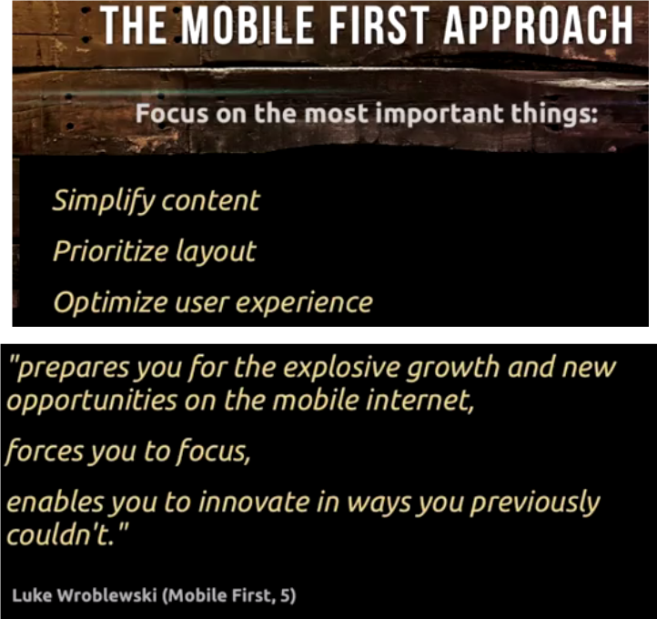
Mobile First

Slide 13
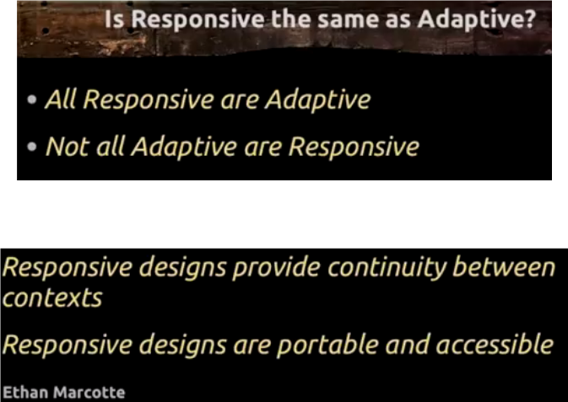
Mobile design
Yo space is much more valuable in a mobile design. You cant have filler materials , random photos o random materials, You have to prioritize
Mobile first gives you a great foundation fa responsive design.
Responsive designs are fluid sites wid series of break points weras adaptive designs are selectively optimized fa d context yo targetting.

Slide 14
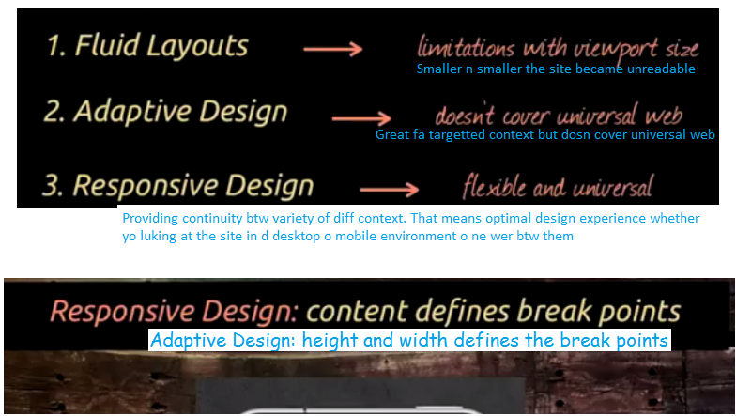
in responsive design our goal is to make a seemless design across variety of context. wer our site designs breaks down thats wer we wanna optimize it

Slide 15
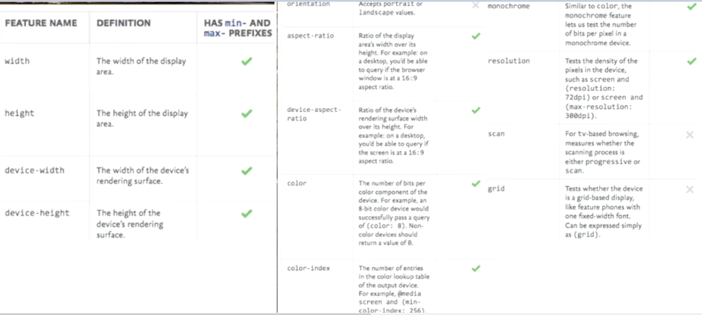
Advanced queries

Slide 16
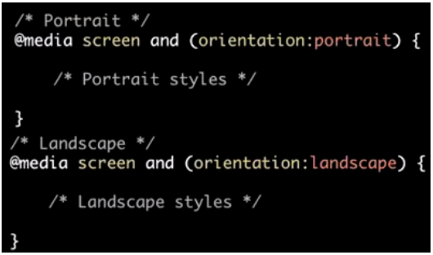
Advanced queries

Slide 17
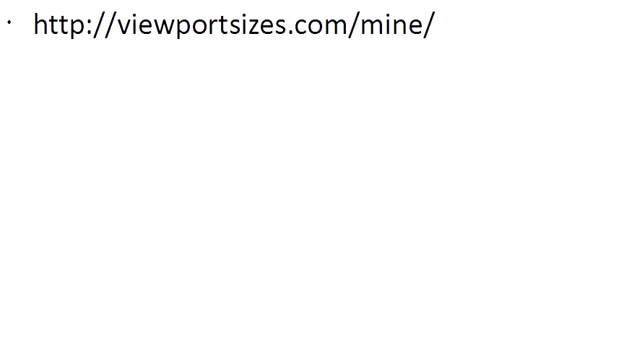
The content property is used with the :before and :after pseudo-elements, to insert generated content.
The ::before selector inserts something before the content of each selected element(s).
Use the content property to specify the content to insert.
Use the ::after selector to insert something after the content.
p::before {
content: "Read this -";
}

